Slide 1
PROJECT – PECUNIA (Banking System)
Presented By - Ayush Soni

Slide 2
TEAM - F
Team Members –
Ayush Soni
Aditya Khatavkar
Akshay Tople
Aishwarya Sarna
Samanway Sahoo

Slide 3
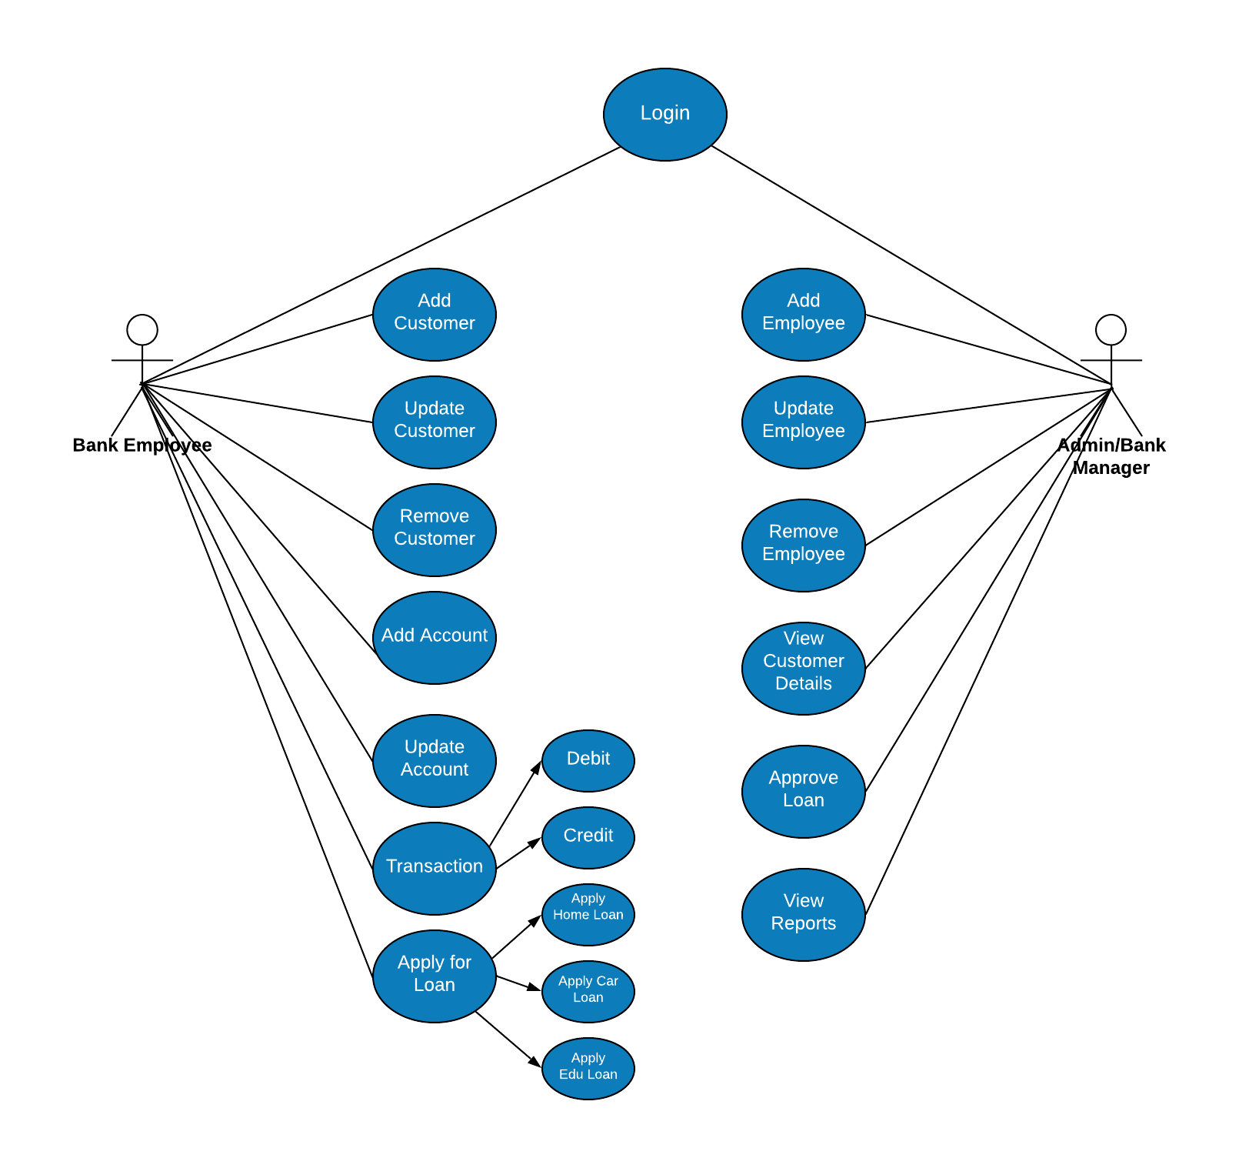
USE CASE DIAGRAM

Slide 4
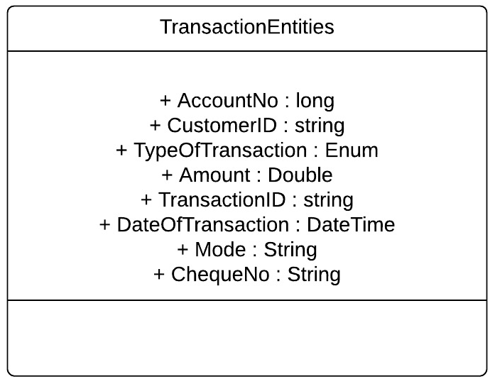
Class Diagram

Slide 5
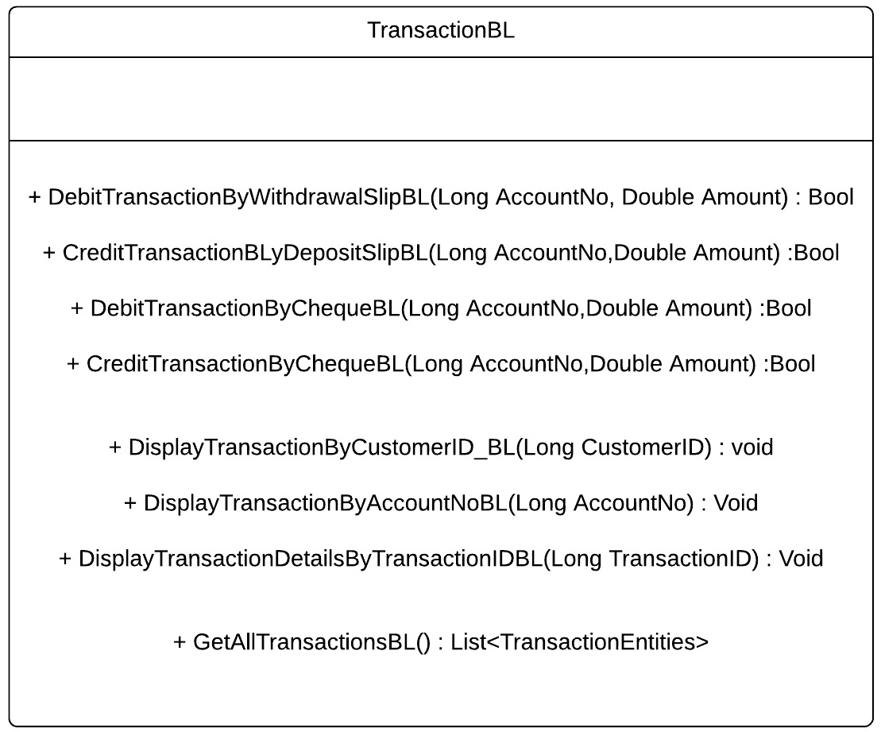
Class Diagram contd..

Slide 6
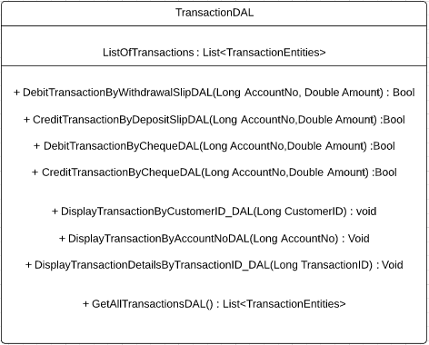
Class Diagram contd….

Slide 7
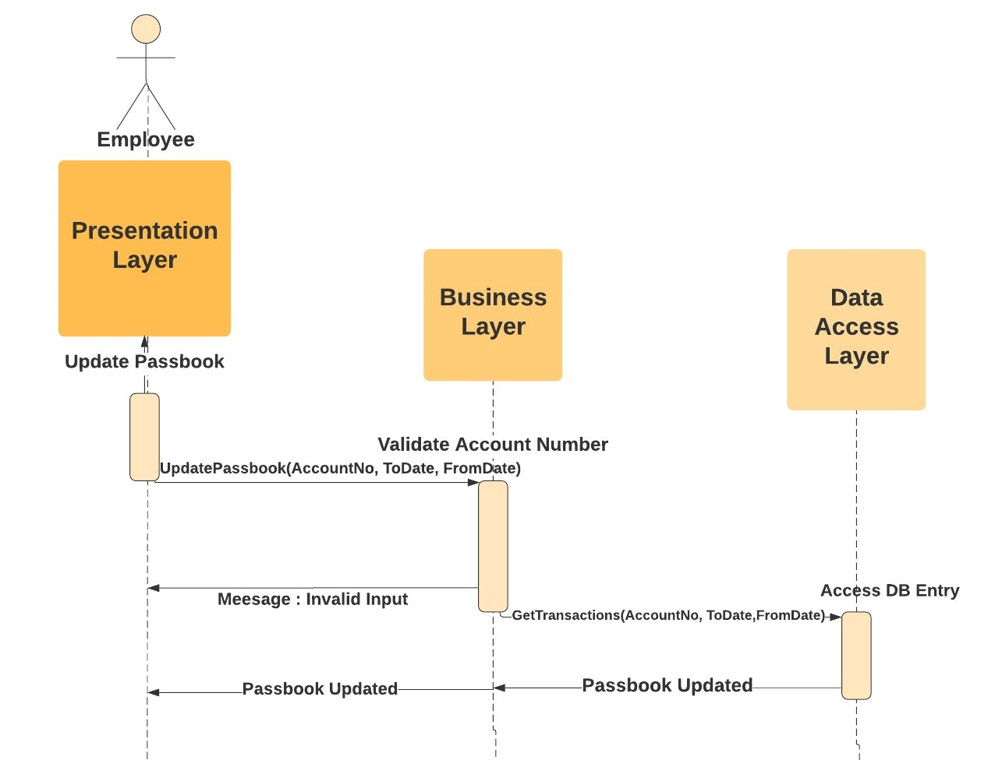
SEQUENCE DIAGRAM
a) ​As a bank employee I want to be able to Update Passbook or print Transactions so that:
All transactions are printed correctly, in chronological order.

Slide 8
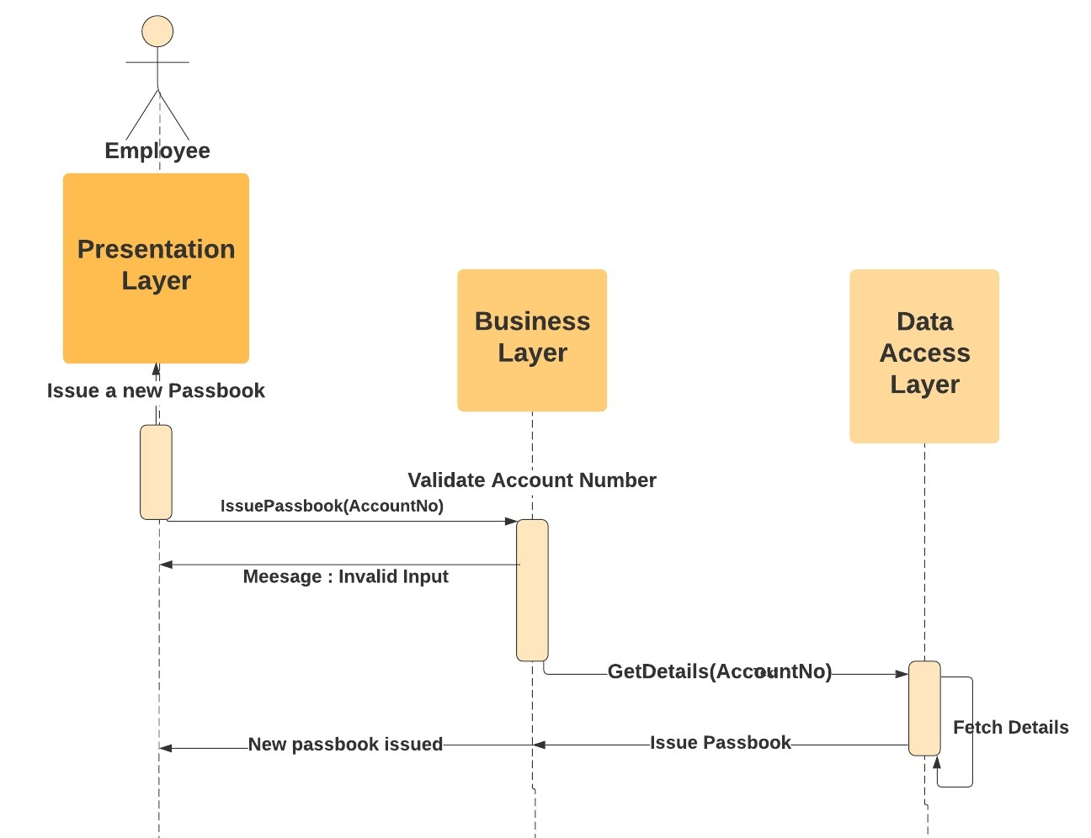
b)​As a bank employee I want to be able to Issue new Passbook, so that:
There is, at max, 10 mins delay.

Slide 9
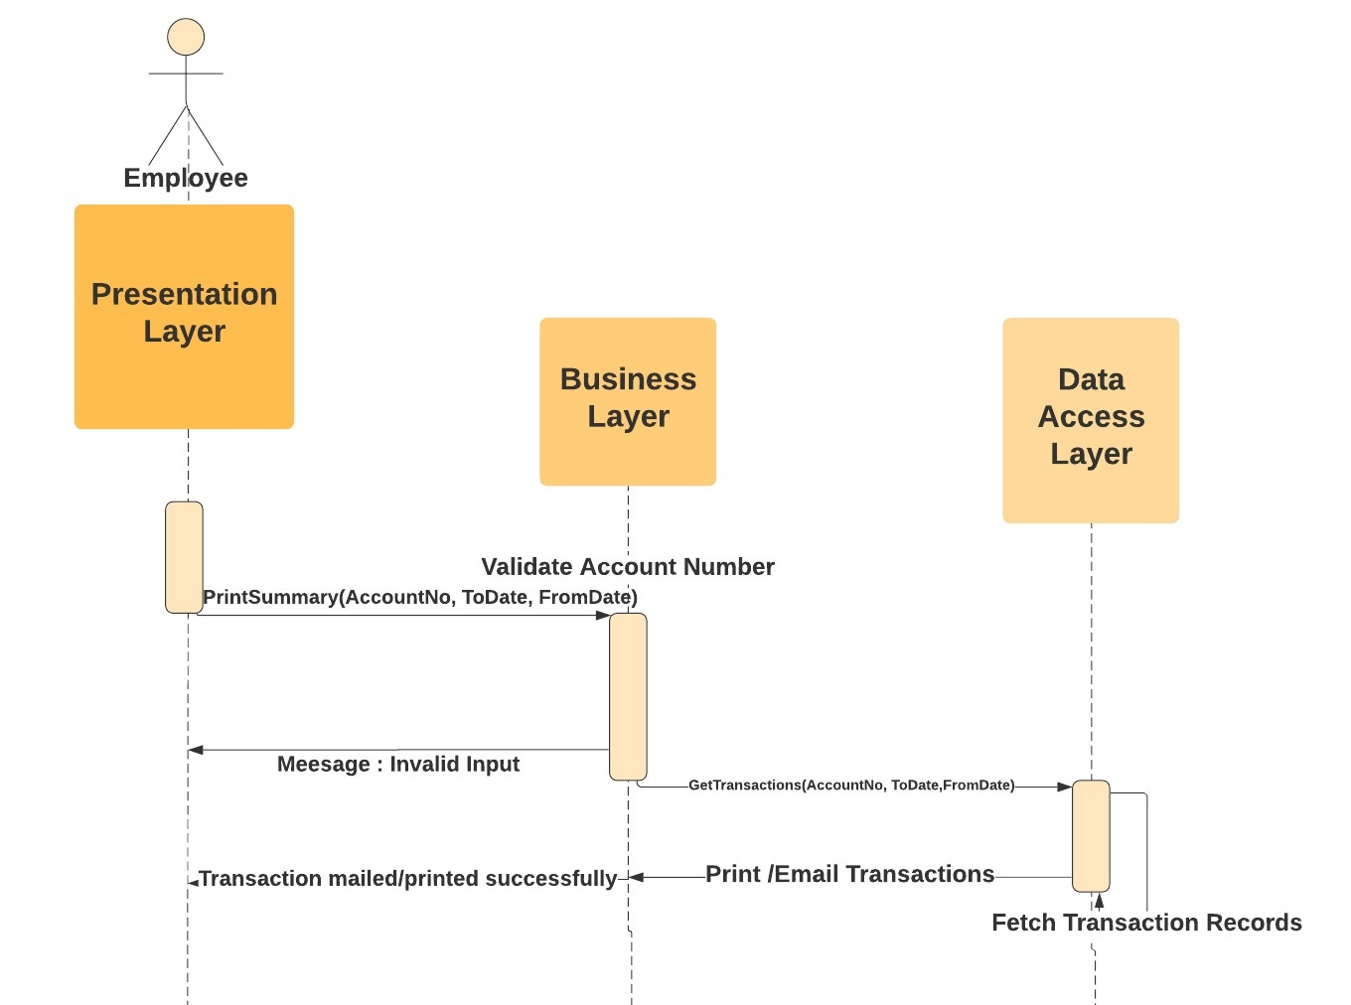
c)​As a bank employee I want to be able to Print/Email Account Summary, so that:
1) All transactions are printed briefly, correctly and in chronological order.

Slide 10
THANK YOU

